Slide 1
AWS EBS Volume
GP2 to GP3 migraton

Slide 2
References
https://www.pluralsight.com/resources/blog/cloud/storage-showdown-aws-vs-azure-vs-gcp-cloud-comparison
https://www.techtarget.com/searchstorage/feature/AWS-vs-Azure-vs-Google-pricing-and-features-compared
https://endoflife.date/amazon-linux

Slide 3
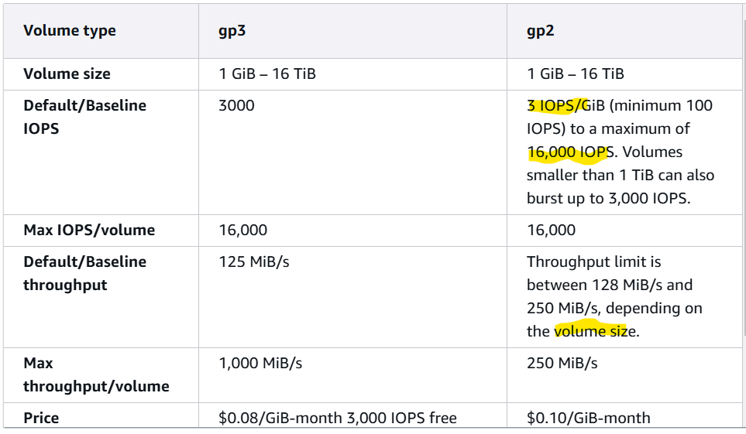
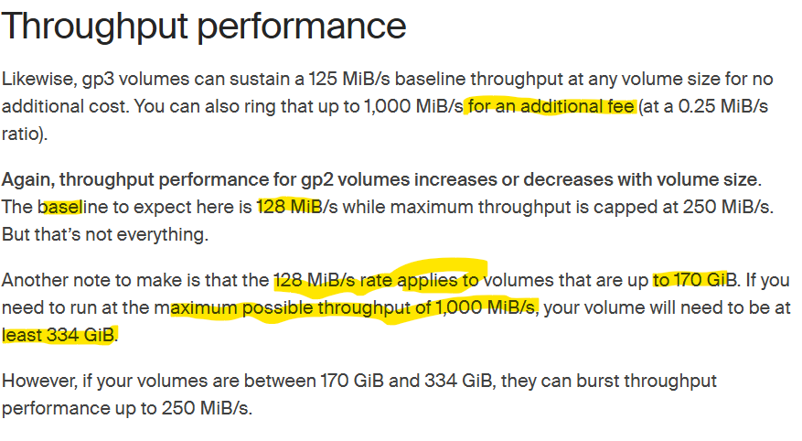
Performance of volume type GP2 & GP3
IOPS (input/output operations per second). IOPS is a measure of a storage device's read/write speed

Slide 4
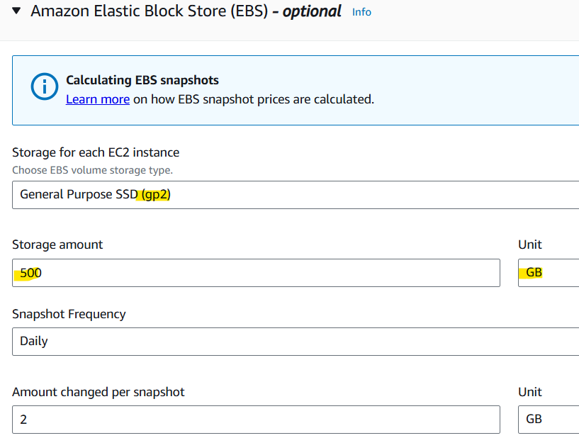
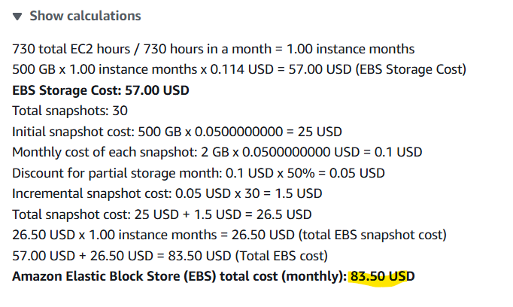
Volume (Disk) Type GP2 (SSD)

Slide 5
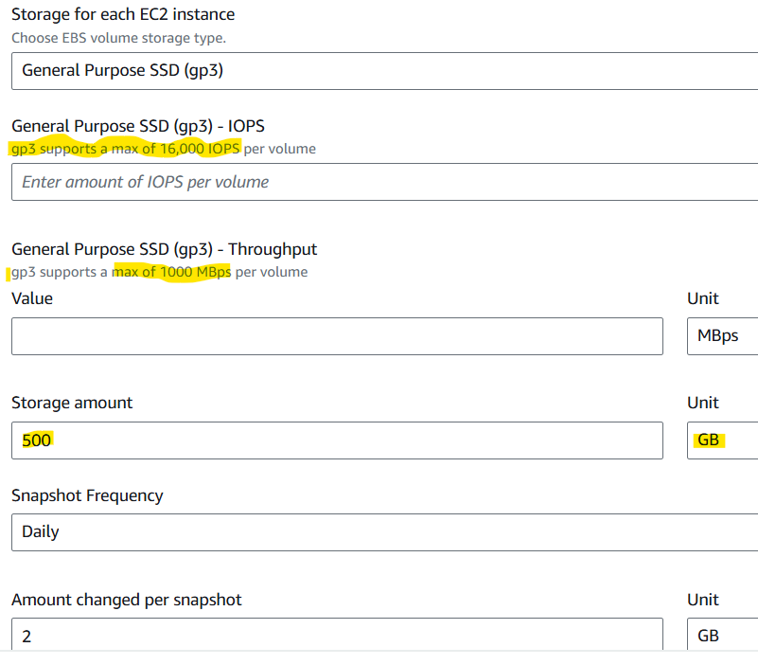
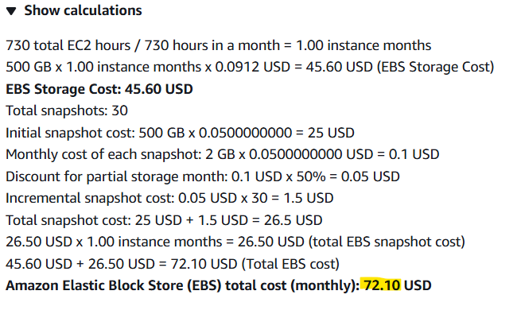
Volume (Disk) Type GP3 (SSD)

Slide 6
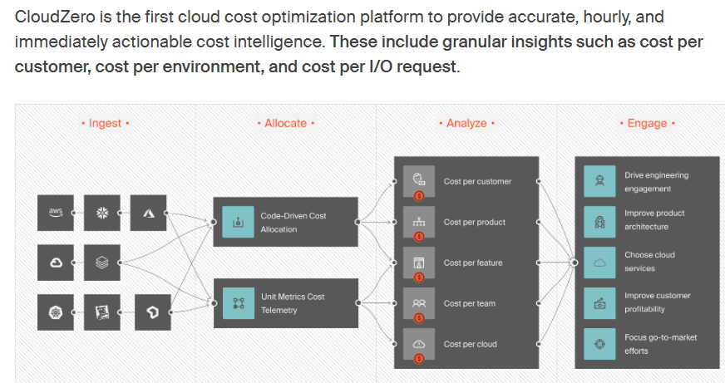
CloudZero compares your EBS costs with other AWS services in one place, such as EBS vs S3 storage costs

Slide 7
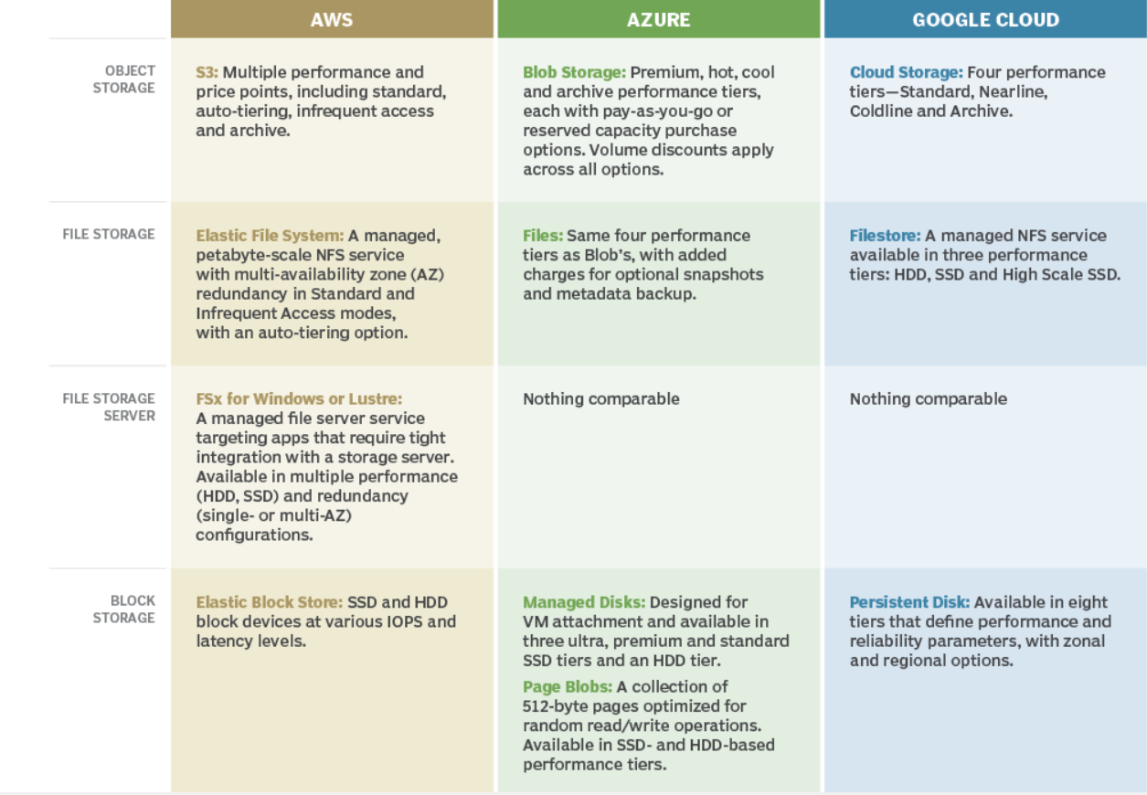
AWS, Azure and Google cloud storage features

Slide 8
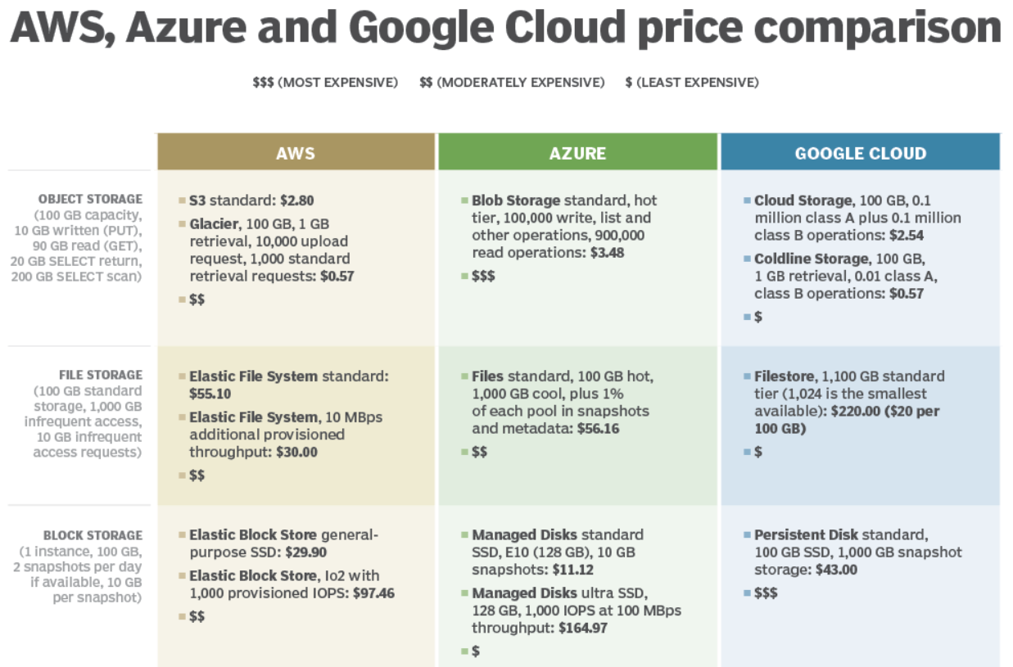

Slide 9
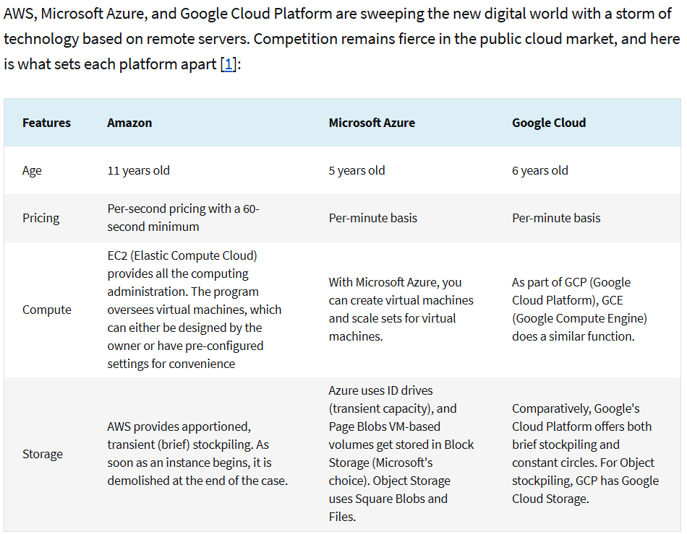
AWS vs. Azure vs. Google Cloud: the key differences

Slide 10
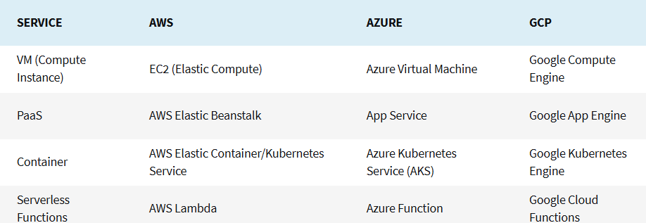
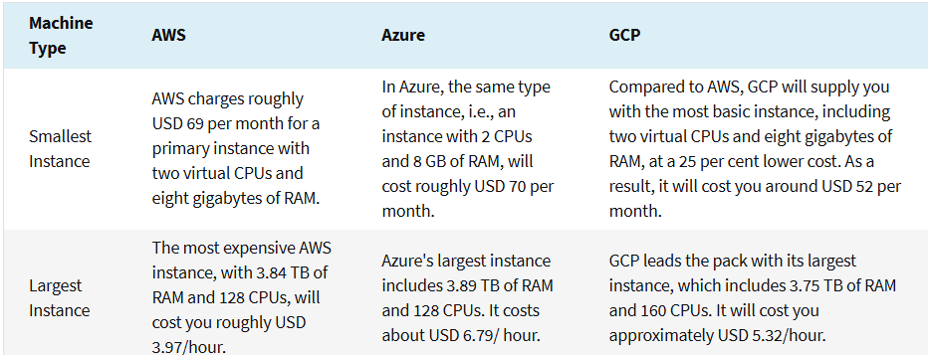
Compute Services
Compute is a term that describes how computers work. Connecting many nodes is simple for a good cloud provider. Here is a look at each platform's computational capabilities individually
Regions and availability
The supported regions and availability are the first things to consider when selecting a cloud provider. Because of issues such as latency and compliance regulations, especially when dealing
with data have a direct impact on your cloud performance.
Here is the Big Three as of March 2023:
Amazon Web Service covers 30 global regions, including two in India (Mumbai and Hyderabad), with 96 availability zones and more than 410 Points of Presence.
Microsoft Azure operates in 54 regions, including several in India (Pune, Chennai, Mumbai, and a planned region in Hyderabad), each with at least three availability zones and 116 edge locations.
Google Cloud Platform comprises 35 cloud regions, including the Delhi National Capital Region, 106 zones, and more than 200 edge locations.

Slide 11
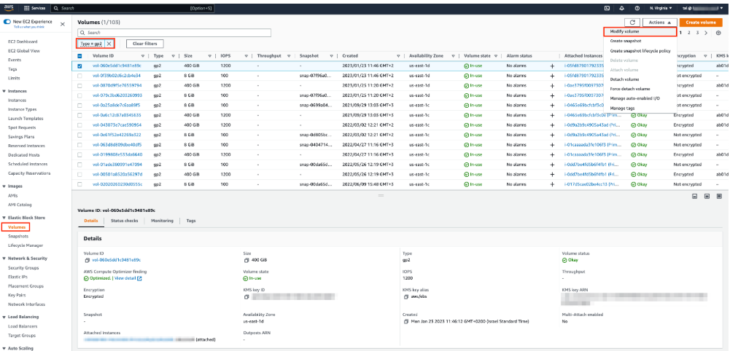
AWS EC2 Console of volume(s)

Slide 12
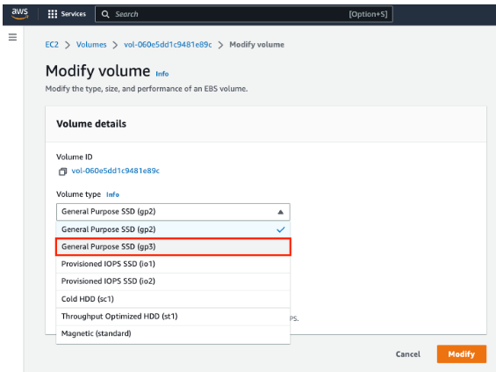
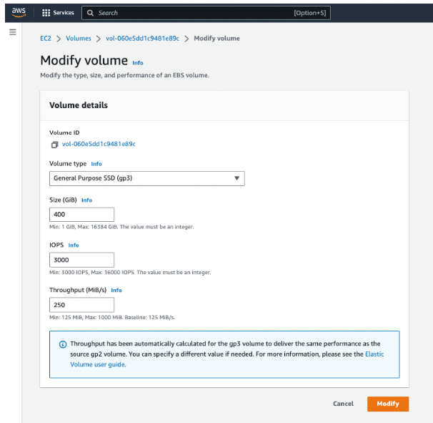
Modify volume Type & Details

Slide 13
Migrate gp2 volumes via AWS CLI
Use the describe-volumes command with the --filters option to get a list of all gp2 volumes:
aws ec2 describe-volumes --filters "Name=volume-type,Values=gp2”
Use the modify-volume command so you migrate to gp3:
aws ec2 modify-volume --volume-type gp3 --volume-id <volume-id>
Where <volume-id> is the Volume ID that you want to migrate to gp3.
The following is an example command to modify a gp2 volume to gp3 and configure specific IOPS and throughput.
aws ec2 modify-volume --volume-type gp3 --iops 4000 --throughput 250 --volume-id <volume-id>
simple bash script that you can use to change all gp2 volumes to gp3
#!/bin/bash #Get all the gp2 volumes GP2_VOLUMES=$(aws ec2 describe-volumes --filters "Name=volume-type,Values=gp2" --query 'Volumes[*].{ID:VolumeId}') #Loop through all the gp2 volumes for volume in $(echo $GP2_VOLUMES | jq -r '.[] | @base64'); do volume=$(echo $volume | base64 --decode) VOLUME_ID=$(echo $volume | jq -r '.ID') echo "Changing volume $VOLUME_ID to gp3" #Change the volume type from gp2 to gp3 aws ec2 modify-volume --volume-id $VOLUME_ID --volume-type gp3 done
https://www.stream.security/post/hands-on-guide-how-to-migrate-from-gp2-to-gp3-volumes

Slide 14
Cost comparison between gp2 and gp3 in the us-east-1 (N. Virginia) Region
gp2 |  |  |  | gp3 – at baseline configuration |  |  |  | gp3 – at gp2 matching configuration
Size of the volume in GiB | Max IOPS | Throughput (MiB/s) | Cost (USD/month) | IOPS | throughput (MiB/s) | Cost (USD/month) | Cost reduction compared to gp2 | IOPS | Throughput (MiB/s) | Cost(USD/month) | Cost reduction compared to gp2
30 | 3000 | 128 | 3.00 | 3000 | 125 | 2.40 | 20% | 3000 | 128 | 2.52 | 16%
100 | 3000 | 128 | 10.00 | 3000 | 125 | 8.00 | 20% | 3000 | 128 | 8.12 | 19%
500 | 3000 | 250 | 50.00 | 3000 | 125 | 40.00 | 20% | 3000 | 250 | 45 | 10%
1000 | 3000 | 250 | 100.00 | 3000 | 125 | 80.00 | 20% | 3000 | 250 | 85 | 15%
2000 | 6000 | 250 | 200.00 | 3000 | 125 | 160.00 | 20% | 6000 | 250 | 180 | 10%
6000 | 16000 | 250 | 600.00 | 3000 | 125 | 480.00 | 20% | 16000 | 250 | 550 | 8%

Slide 15
Migration from Amazon Linux AMI (AL1) to AL2 or AL2023
Release | Released | Standard Support | Security Support | Latest
2023 | 1 year and 9 months ago(01 Mar 2023) | Ends in 3 months(15 Mar 2025) | Ends in 3 years(15 Mar 2028) | 2023.6.20241121.0(03 Dec 2024)
2 | 6 years ago(26 Jun 2018) | Ends in 6 months and 2 weeks(30 Jun 2025) | Ends in 6 months and 2 weeks(30 Jun 2025) | 2.0.20241113.1(16 Nov 2024)
AMI 2018.03 | 6 years ago(25 Apr 2018) | Ended 3 years and 11 months ago(31 Dec 2020) | Ended 11 months ago(31 Dec 2023) | 2018.03.0.20231218.0(12 Nov 2024)
AMI 2017.09 | 7 years ago(03 Nov 2017) | Ended 3 years and 11 months ago(31 Dec 2020) | Ended 11 months ago(31 Dec 2023) | 2017.09.1.20180409(10 Apr 2018)
AMI 2017.03 | 7 years ago(07 Apr 2017) | Ended 3 years and 11 months ago(31 Dec 2020) | Ended 11 months ago(31 Dec 2023) | 2017.03.1.20170812(03 Nov 2017)
AMI 2016.09 | 8 years ago(16 Nov 2016) | Ended 3 years and 11 months ago(31 Dec 2020) | Ended 11 months ago(31 Dec 2023) | 2016.09.1.20161221(03 Nov 2017)
AMI 2016.03 | 8 years ago(22 Mar 2016) | Ended 3 years and 11 months ago(31 Dec 2020) | Ended 11 months ago(31 Dec 2023) | 2016.03
AMI 2015.09 | 9 years ago(22 Sep 2015) | Ended 3 years and 11 months ago(31 Dec 2020) | Ended 11 months ago(31 Dec 2023) | 2015.09
AMI 2015.03 | 9 years ago(24 Mar 2015) | Ended 3 years and 11 months ago(31 Dec 2020) | Ended 11 months ago(31 Dec 2023) | 2015.03
AMI 2014.09 | 10 years ago(23 Sep 2014) | Ended 3 years and 11 months ago(31 Dec 2020) | Ended 11 months ago(31 Dec 2023) | 2014.09
AMI 2014.03 | 10 years ago(27 Mar 2014) | Ended 3 years and 11 months ago(31 Dec 2020) | Ended 11 months ago(31 Dec 2023) | 2014.03
AMI 2013.09 | 11 years ago(30 Sep 2013) | Ended 3 years and 11 months ago(31 Dec 2020) | Ended 11 months ago(31 Dec 2023) | 2013.09
AMI 2013.03 | 11 years ago(27 Mar 2013) | Ended 3 years and 11 months ago(31 Dec 2020) | Ended 11 months ago(31 Dec 2023) | 2013.03
AMI 2012.09 | 12 years ago(11 Oct 2012) | Ended 3 years and 11 months ago(31 Dec 2020) | Ended 11 months ago(31 Dec 2023) | 2012.09
AMI 2012.03 | 12 years ago(28 Mar 2012) | Ended 3 years and 11 months ago(31 Dec 2020) | Ended 11 months ago(31 Dec 2023) | 2012.03
AMI 2011.09 | 13 years ago(26 Sep 2011) | Ended 3 years and 11 months ago(31 Dec 2020) | Ended 11 months ago(31 Dec 2023) | 2011.09
AMI 2010.11 | 14 years ago(01 Dec 2010) | Ended 3 years and 11 months ago(31 Dec 2020) | Ended 11 months ago(31 Dec 2023) | 2010.11

Slide 16
Migration AMZ Linux2 to AMZ Linux3
Launch AL3
Fix all vulnerabilities as per compliance.
Achieve 95% bench mark as per compliance.
Create new AMI (treat as golden image/template image)
Create EC2 server from golden image with respective Security and subnet groups.
Hostname should be change
Reach application stake holder to deploy their application. (or) ask which folder to be copy from old to new version AL3 and reset environment variables.
Application team to be test and signoff to live with new version AL3.
Imp note : s3, sns, API’s , RDS , context.xml, catalina.log, etc services to be keep track.
Take AMI backup of old AMZ L2 servers.
Take down time
Delete old server
Switch IP’s (re-assign) to old of newly launched servers.
It reduce the traffic, remove ip hardcoded in application code.
Fine-tuning blue/green deployments on application load balancer
https://aws.amazon.com/blogs/devops/blue-green-deployments-with-application-load-balancer/

Slide 17
Blue/Green Deployment
Blue/green deployment is a software deployment approach that helps organizations deploy frequent updates while maintaining high quality and a smooth user experience. The blue/green deployment method helps to minimize the risk of introducing flaws during software updates while limiting downtime during the transition to new versions.
This model uses two similar production environments (blue and green) to release software updates. The blue environment runs the existing software version, while the green environment runs the new version. Only one environment is live at any time, receiving all production traffic. Once the new version passes the relevant tests, it is safe to transfer the traffic to the new environment. If something goes wrong, traffic is switched to the previous version.
https://codefresh.io/learn/software-deployment/what-is-blue-green-deployment/
Overview of Amazon RDS Blue/Green Deployments
https://docs.aws.amazon.com/AmazonRDS/latest/UserGuide/blue-green-deployments-overview.html
Benefits, Drawbacks, and Use Cases
https://medium.com/@lalitha.cs.16_5385/blue-green-deployment-in- aws-benefits-drawbacks-and-use-cases-d05d48013529
Process Work: The main prerequisite for a blue/green deployment is having two identical production environments, with a router, load balancer, or service mesh that can switch traffic between them.
The main prerequisite for a blue/green deployment is having two identical production environments, with a router, load balancer, or service mesh that can switch traffic between them.
The blue/green deployment process works as follows:
Deploy new version—deploy the new (green) version alongside the current (blue) version. Test it to ensure it works as expected, and deploy changes to it if needed.
Switch over traffic—when the new version is ready, switch overall traffic from blue to green. This should be done seamlessly so end-users aren’t interrupted.
Monitor—closely monitor how users interact with the new version and watch out for errors and issues.
Deploy or rollback—if there is a problem, immediately roll back by switching traffic back to the blue version. Otherwise, keep traffic on the green version and continue using it. The green version now becomes the blue (current) version, and a new version can be deployed alongside it as the “new green” version.

